Slide 1

AHS Artificial Intelligence Club (No videos)
Sponsored by: Mr. Hatcher

Slide 2
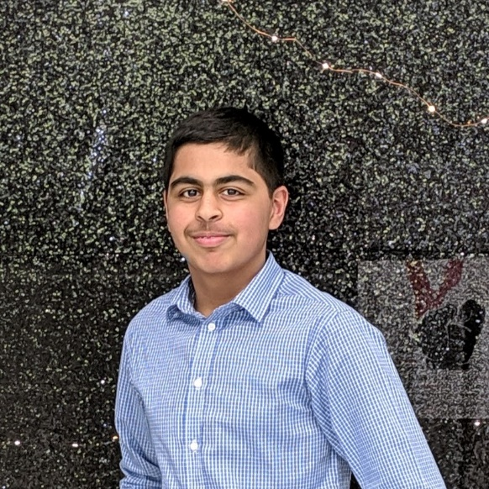
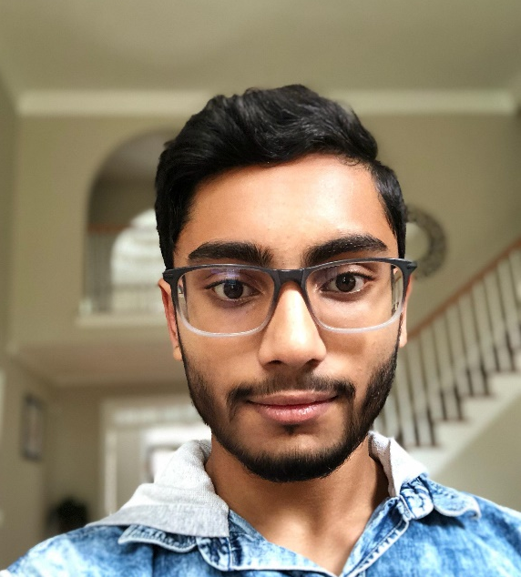
Leadership Team
President
Vice-President
Kunal Aneja
Srihith Pallamreddy

Slide 3
WHAT IS
ARTIFICIAL
INTELLIGENCE
AI as a branch of computer science that allows computers to make predictions and decisions to solve problems.
Implantations
Google/Siri – Voice recognition
Self-driving cars – Line/Object Detection
School security cameras – Object Detection
Made in the 1955s

Slide 4

Machine Learning Definition
Machine Learning
Machine Learning is the science of getting computers to learn and act like humans do, and improve their learning over time in autonomous fashion, by feeding them data and information in the form of observations and real-world interactions.

Slide 5



What do we do in this club?
Publish
Finish and publish to companies
It isn’t just all coding
Implement
What is needed to complete the project. Run tests and optimize weights and confidence.
Plan
Produce a real-life problem that could be solved with AI
Learn
Guest Speakers to learn what is AI and real life example. Look into previously made projects

Slide 6
Fields of AI
Face Recognition
Natural Language Processing
Track and detect who’s face is in the camera frame from previous taken photos for data
Understanding and reading human handwriting
Object Detection/Tracking
Line detection
Tracking lines and edges in a picture especially useful in automatous driving
Track and detect what objects are shown and track their movement throughout the video.

Slide 7
Requisites
Personal Computer
OSP
A $15 dollar requirement is needed. This will be used to buy devices like webcam, pay for gpu, and food
Able to install software on it and be able to bring it to school every meeting.
Coming and working at the meetings
Follow us on Instagram
Must be able to come to all meetings. If you can’t come to meetings talk to us in advance
Follow us on Instagram for updates and much more
@aiclub.ahs

Slide 8
The future
01
Basic Coding
Higher level projects
03
Basic coding in different languages and getting the feel of everything. Also need to know different libraries often used in AI.
These projects can be used in real life and get implemented by a real company, usually works with internships.
02
Programming AI in real projects
04
Jobs
Once you get out of college or maybe even in college, you will find jobs left, right and center
Look into real life problems. Design, build, program, and test these projects. Through-out this club, it will also help you with your resume

Slide 9
Agenda (Tentative)
01
Learn
Guest Speakers from many different companies to learn and talk about AI.
02
Personal Project
Work in small groups/individually on a project. It can be decided on its own. Participate in hackathons to improve coding skills.
03
Work together on a project
Start a big project that could be used in real life or present to. Could also build on personal project
04
Develop projects into something tangible
Develop project and use it.

Slide 10
Projects
Manipulate sound
Automatous vehicle driving
Ideas where AI can be used
Natural Language Processing (NLP) Signature tracking or text reading.
Face Tracking drone
Facial recognition for behavior in classroom and record attendance
Detect cancer
These are just a couple

Slide 11

Projects
Simple robot
Camera
Ideas where AI can be used
Sensors
Nvidia Jetson GPU

Slide 12
CAFET
2018-19

Slide 13
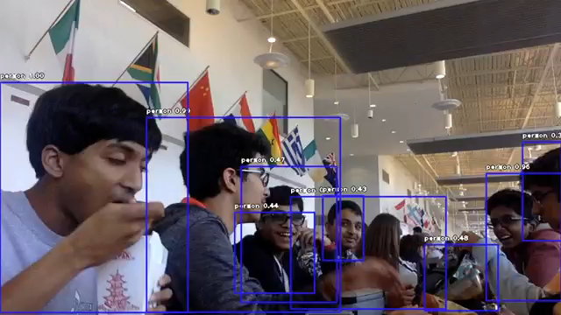
Object Detection
Object Detection Demo
Lunch

Slide 14
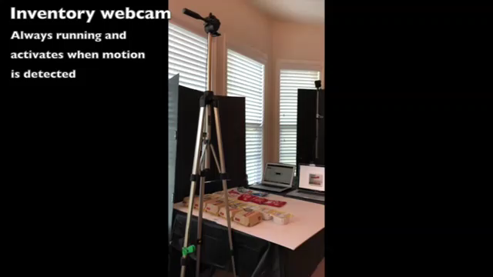
Live Demo
Full Process
Lunch

Slide 15
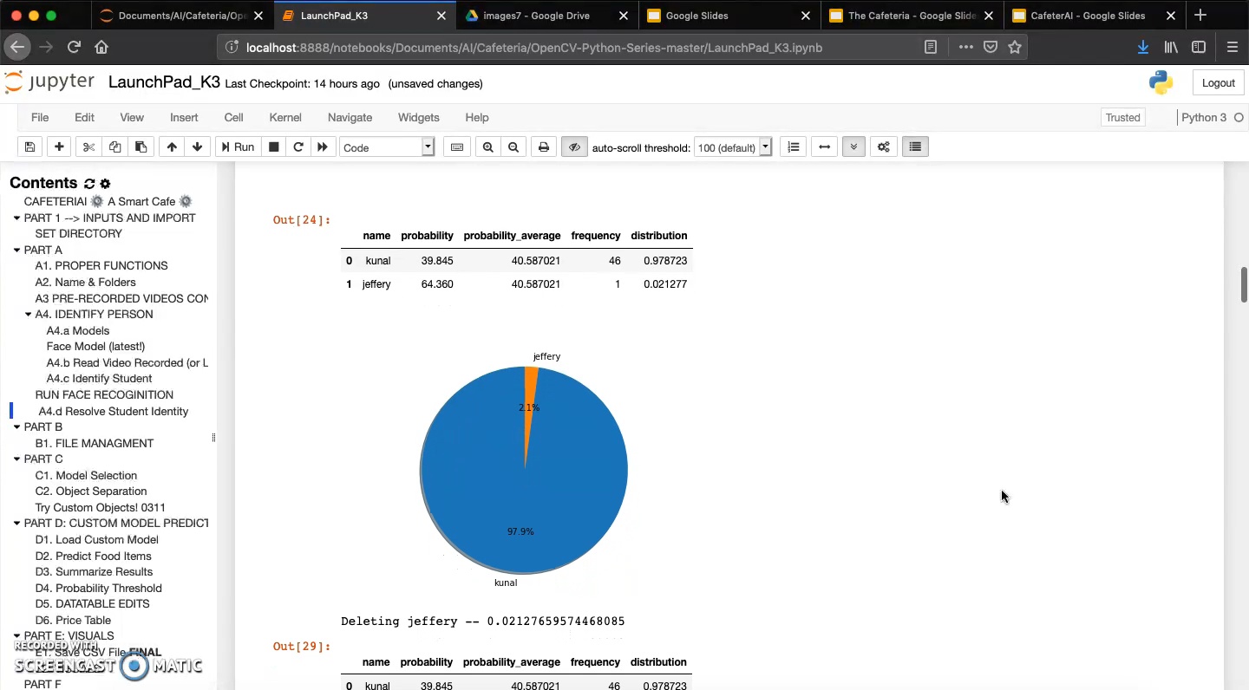
Output
Full Process
Data

Slide 16

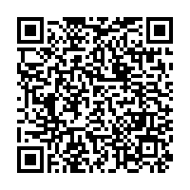
Forms
Sign Up Form
Instagram
Remind
Mail
@aiclub.ahs
Text 81010
@b7gkk9
aiclub.ahs@ gmail.com

Slide 17
Thank You
Technology Tomorrow, Today

Slide 18

AI CLUB
aiclub-ahs
www.tinyurl.com/
Go to Mr. Hatcher’s Room, 1271, for more information

